Slide 1
INNOVATIONS IN HIV TESTING AND LINKAGE TO PREVENTION AND CARE
HIV TESTING AND LINKAGE STRATEGIES FOR MEN AND YOUNG PEOPLE IN SA
DR THATO CHIDARIKIRE
HIV PREVENTION STRATEGIES
NDOH
Date: 23rd July 2018
HALL 11A

Slide 2
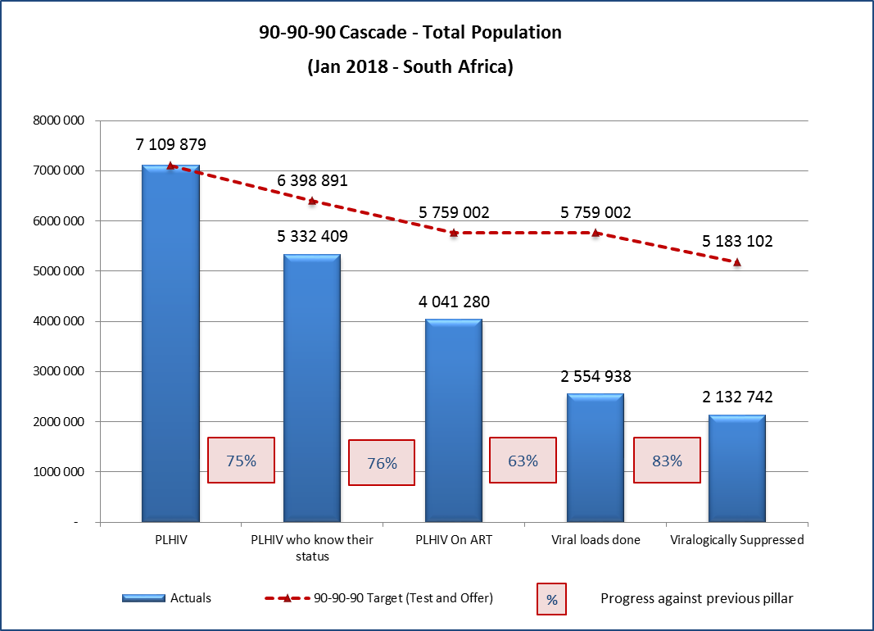
Progress to 90-90-90 – South Africa
Adults and Children
1st, 2nd and 3rd 90 are behind target
Particularly poor performance in retention and recording
Data sources:
PLHIV estimates from Thembisa province-specific models. Value for 2018 PLHIV used.
Known status from preliminary household survey data available at the national level. This data will be disaggregated by Province in the next few months.
Viral loads done and suppressed as recorded in the Tier system
Only public sector results are reflected
2
Notes:
Note to Yogan:
The cascades all use 2017 PLHIV estimates. They therefore depict where we are in terms of 90-90-90 today.
The Surge target of 6,1m is calculated on the PLHIV estimate for 2020. The targets predict where we will have to be by 2020.

Slide 3
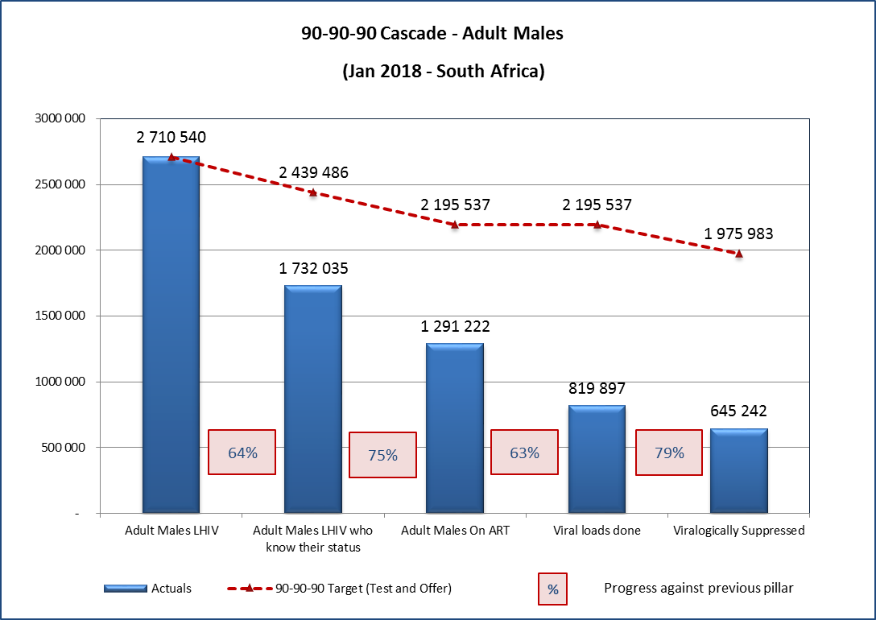
Progress to 90-90-90 – South Africa
Adults Males
1st, 2nd and 3rd 90 are behind target
Case finding and Treatment coverage lower than in females
Poor performance in retention and recording
Data sources:
PLHIV estimates from Thembisa province-specific models. Value for 2018 PLHIV used.
Known status from preliminary household survey data available at the national level. This data will be disaggregated by Province in the next few months.
Viral loads done and suppressed as recorded in the Tier system
Only public sector results are reflected
3

Slide 4
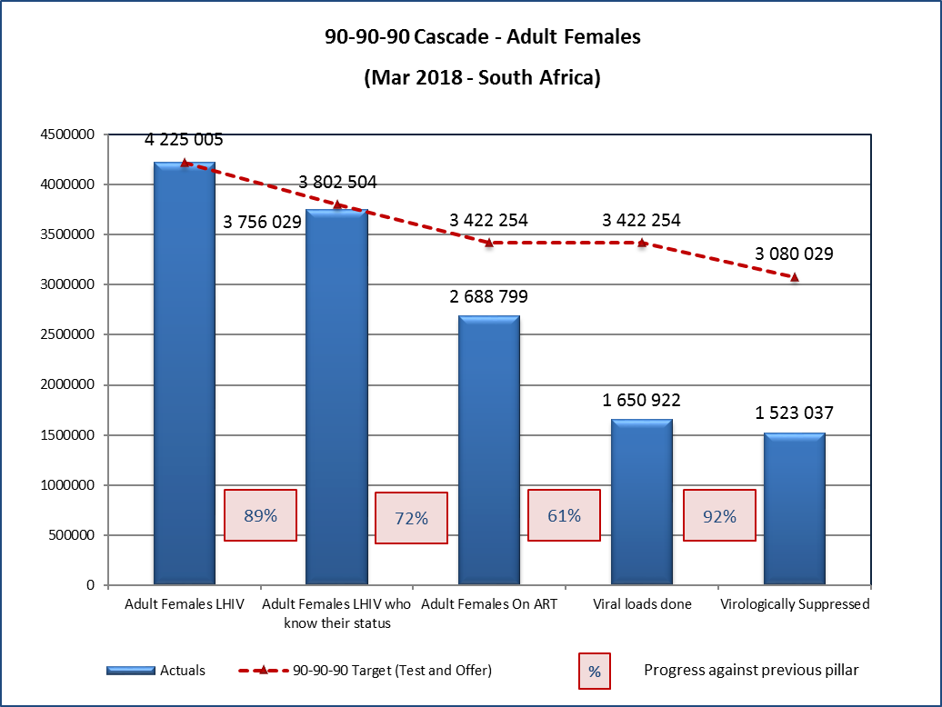
Progress to 90-90-90 – South Africa
Adults Females
1st, 2nd and 3rd 90 are close to target
Case finding and Treatment coverage higher than in males
Strengthen retention and recording

Slide 5




Phylogenetic analysis shows the
Infection Pathway
Africa Centre identified phylogenetically linked HIV transmission networks in Hlabisa
Source: Dellar R, Tanser F, Abdool Karim Q, et al. Manuscript in preparation
High HIV incidence men mean age 27 years (range 23-35 years)
Very young women acquire HIV from men, on average,
8 years older
Men and women > 24 years usually acquire HIV from similarly aged partners
39% of the men
linked to a woman < 25 are simultaneously also linked to a woman 25-40 years
High HIV risk women
Mean age 18 years
(range 16-23 years)
High HIV prevalence women
Mean age 26 years
(range 24-29 years)
When teen women reach mid-20s they continue the cycle

Slide 6
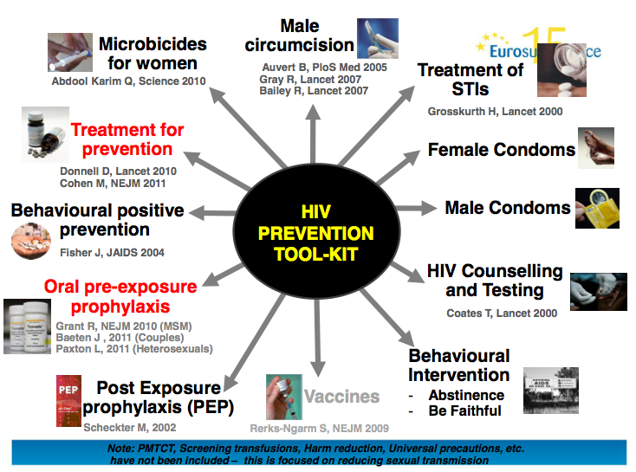
Combination Prevention interventions

Slide 7
Phylogenetic analysis shows the
Infection Pathway
Africa Centre identified phylogenetically linked HIV transmission networks in Hlabisa
Source: Dellar R, Tanser F, Abdool Karim Q, et al. Manuscript in preparation
High HIV incidence men mean age 27 years (range 23-35 years)
Very young women acquire HIV from men, on average,
8 years older
Men and women > 24 years usually acquire HIV from similarly aged partners
39% of the men
linked to a woman < 25 are simultaneously also linked to a woman 25-40 years
High HIV risk women
Mean age 18 years
(range 16-23 years)
High HIV prevalence women
Mean age 26 years
(range 24-29 years)
When teen women reach mid-20s they continue the cycle

Slide 8
Approaches to reaching men and AGYW
Approaches: Partners support and targeting
Time:
  After working/school hours (extended working hours)
  Weekends
Place: Bring services to where men/AGYW are
  Outreach activities
  Home based
  Youth Hubs
  Self screening
  Use of Apps for accessing information
Service delivery approach
  Youth/Men friendly

Slide 9
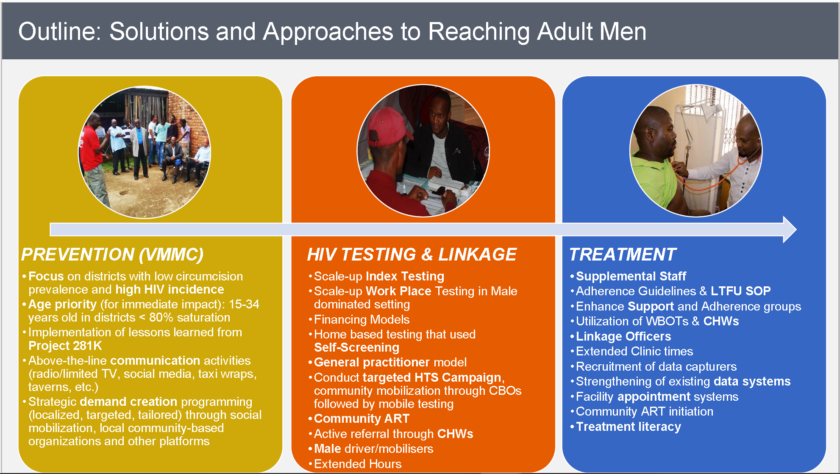
Cycle of HIV transmission

Slide 10
Approaches to reaching men cont…
HTS and Linkage to care: Reaching men in hostels using soccer as a tool to bring them together

Slide 11
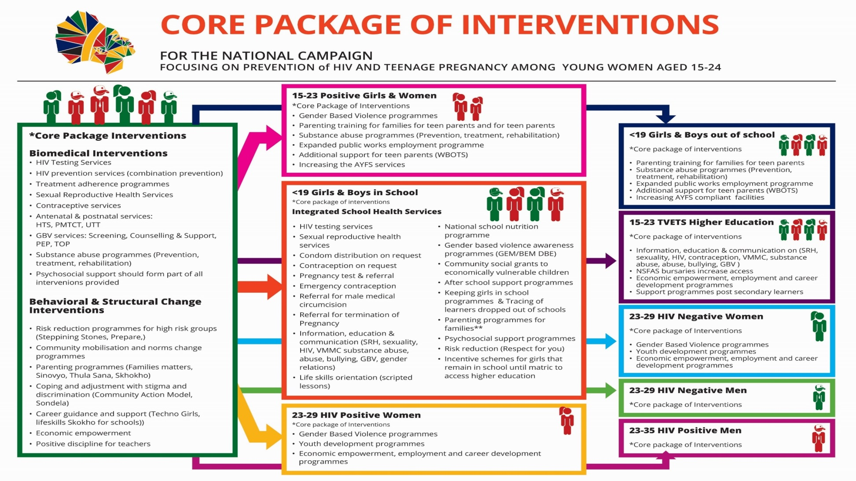
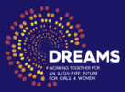
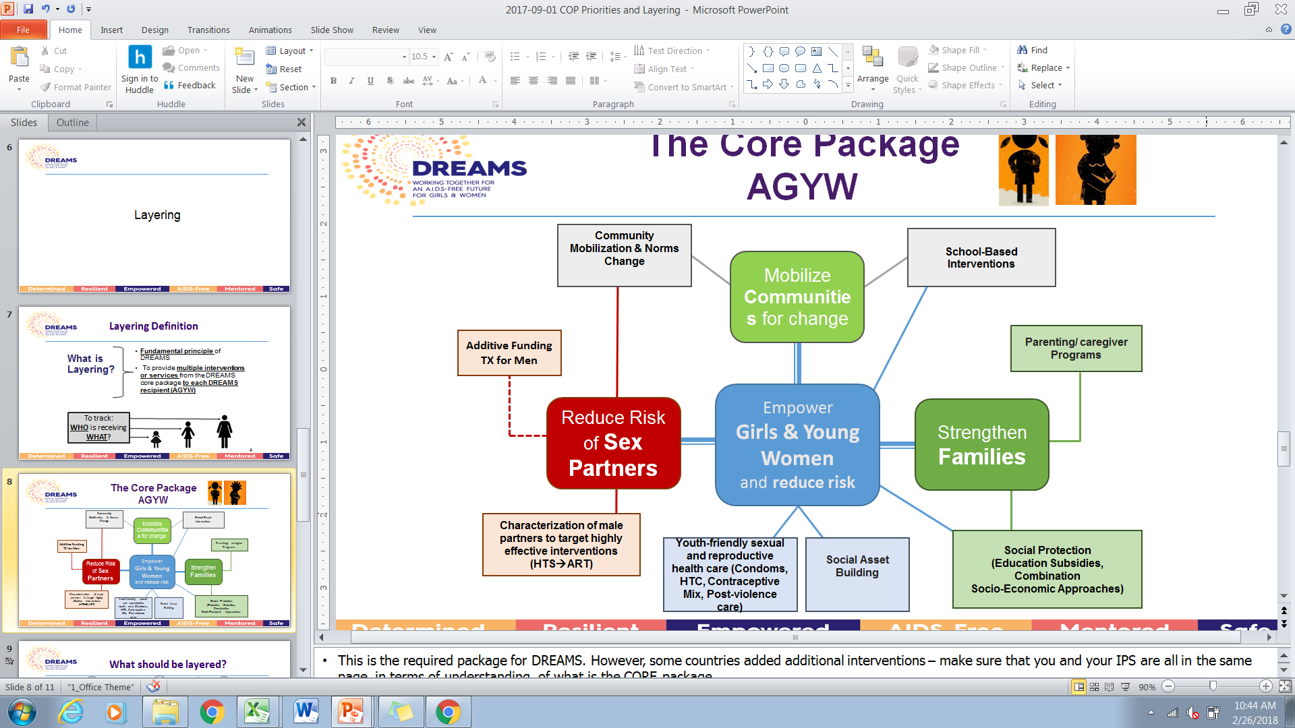
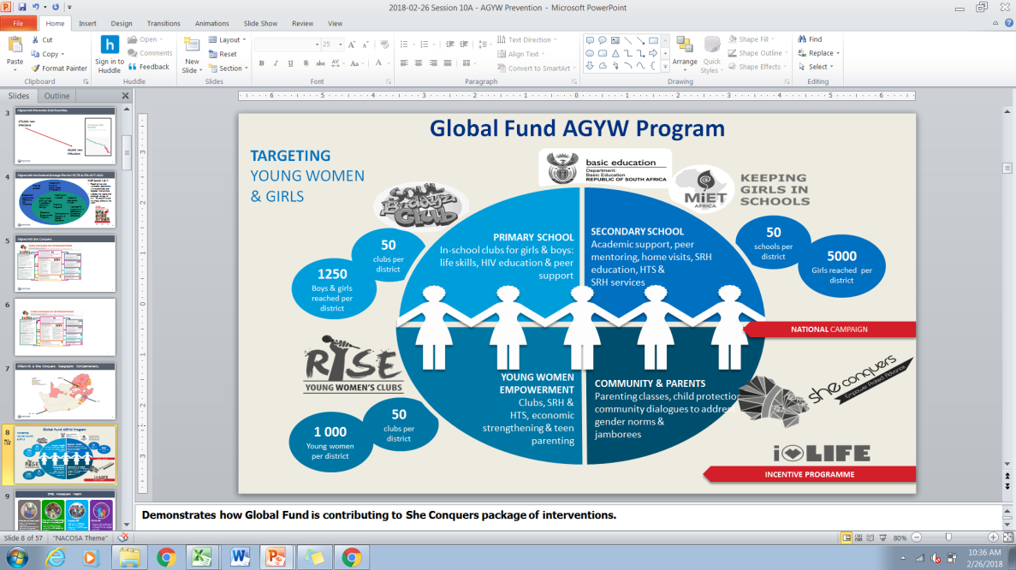
Interventions for AGYW
Notes:
AGYW Prevention (including DREAMS) aligned with goals and activities in the NSP 2017-2022

Slide 12
Launched by the Deputy President June 2016
1. Decrease new HIV infections in adolescent girls and young women
(decrease by at least 30% from 90 000 per year to less than 60 000)
2. Decrease teen pregnancies
(decrease <18 deliveries from 73 000 by at least 30% to 50 000)
3. Keep girls in school till matric
(increase retention by 20%)
4. Decrease sexual and gender based violence
(decrease by 10% )
5. Increase economic opportunities for young people
(increase youth employment by 10% )

Slide 14



WAY FORWARD AND CONCLUSION
Self screening
Digital platforms
Youth Clubs
SRH Services and condoms
Door-to-door
Mobile Sites
Stand-Alone Site
School-based interventions
Treatment (PEP, PreP, ART )
Men HTS & linkage to care

Slide 15

THANK YOU
  www.doh.gov.za
  Thato.chidarikire@health.gov.za

